Slide 1

ETHAPREDICT AI
Machine Learning-Based Prediction of Ethanol Fuel Consumption,
Range and Refueling Time
A Data Science & AI Project | Smart Ethanol Fuel Intelligence System

Slide 2



The Problem
Fuel level & ethanol blend %
Can machine learning predict fuel consumption, remaining range, and refueling time for an ethanol-blended vehicle — using live vehicle telemetry, fuel data, and driving conditions?
Traffic, road type, driving pattern
Temperature & AC usage
Why it matters
Higher ethanol blends carry less energy per liter (E85 has ~27% less energy than gasoline, per the US DOE), so mileage and range shift with blend, conditions, and vehicle behavior — a single static mileage number isn't enough.
Speed, RPM, acceleration, load
EthaPredict AI
2

Slide 3




System Architecture
>
>
>
>
Vehicle & Fuel Data
Preprocessing
ML Model
Consumption Prediction
Range, Time & Alert
Speed, RPM, temp, load, ethanol %, fuel level
Cleaning, encoding, scaling
Random Forest / XGBoost
Predicted fuel use (L)
Km, hours, refuel warning
Five stages turn raw driving conditions into an actionable refuel decision.
EthaPredict AI
3

Slide 4
Dataset Snapshot
Physics-informed synthetic data, built to mirror real vehicle telemetry
12,006
14
4
8
clean rows
(after cleaning)
raw features
captured
ethanol blends
E0 / E10 / E20 / E85
engineered
features
Deliberately staged data-quality issues (for the cleaning phase):
Missing values (3-5%)
Duplicate rows (~2%)
Sensor outlier spikes (~1%)
Inconsistent categorical text
EthaPredict AI
4

Slide 5
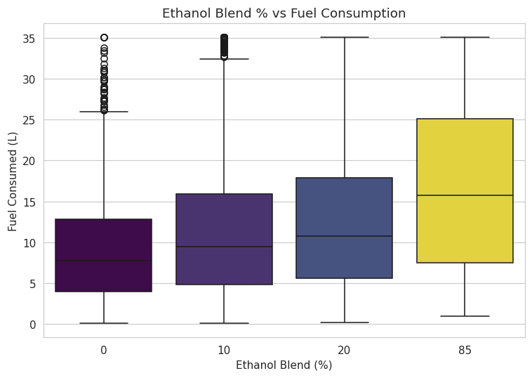
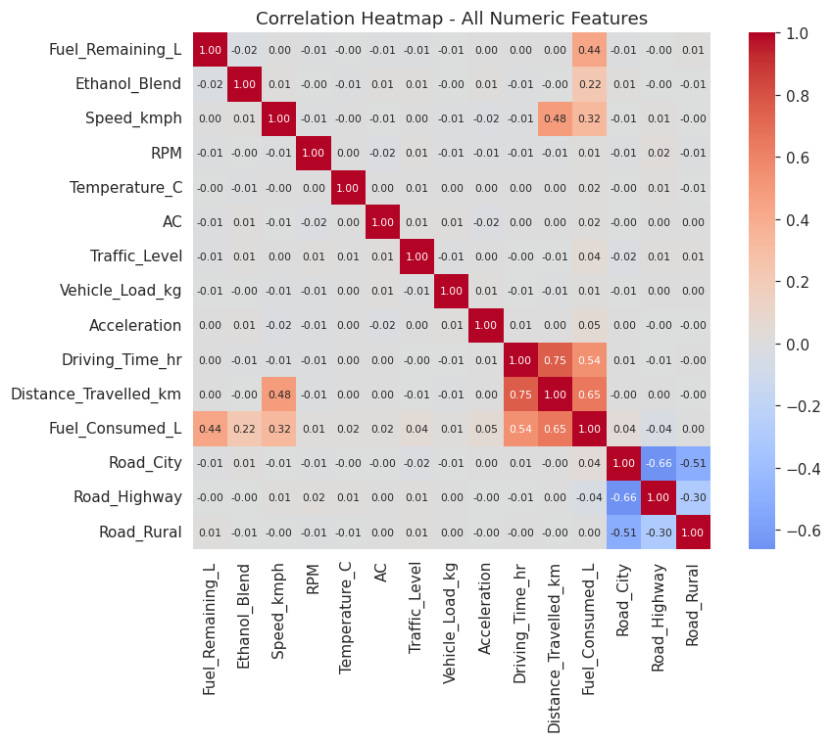
Exploratory Insights
Key finding: Ethanol blend, distance, and driving time drive fuel consumption most strongly. Traffic, AC, and load effects are real but smaller — visible only after engineering a per-km consumption rate.
EthaPredict AI
5

Slide 6


Feature Engineering
Consumption Rate (L/km)
Traffic Score
Isolates per-km driving effects from trip length
Weighted composite of traffic level + road type
Driving Intensity
AC Load Indicator
Normalized blend of speed, acceleration, RPM
AC usage weighted by ambient temperature
Remaining Time (hr)
Remaining Range (km)
Range ÷ average speed
Fuel remaining × predicted efficiency
Leakage guard: efficiency/range/time features are excluded from model inputs — they're derived from the target itself.
EthaPredict AI
6

Slide 7
Model Comparison
80/20 train-test split · trained on 17 engineered features
BEST MODEL
Random Forest
R²
0.989
MAE
0.50 L
RMSE
0.89 L
Tree ensembles capture non-linear interactions (traffic × AC × load) that linear regression misses.
EthaPredict AI
7

Slide 8
Prediction Engine — Example
Input: 12 L remaining · E20 · high traffic · AC on · city driving
8.54 L
70.3 km
1.41 hr
Predicted Consumption
Remaining Range
Remaining Time
⚠ WARNING — plan to refuel soon (within ~70 km)
EthaPredict AI
8

Slide 9

Environmental Module — CO2
Same 100 km trip, compared across ethanol blends
The nuance
Ethanol has lower carbon content per liter (1.51 vs 2.31 kg CO2/L) — but blended vehicles also burn more liters per km. In this model, E85's higher fuel use outweighs its lower carbon factor, so total trip CO2 is highest at E85.
EthaPredict AI
9

Slide 10
Roadmap Coverage
✓
1. Problem Definition
✓
2-3. Synthetic Dataset
✓
4. Data Cleaning
✓
5. Exploratory Data Analysis
✓
6. Feature Engineering
✓
7. Model Training
✓
8. Model Evaluation
✓
9. Prediction Engine
✓
10. Dashboard (Streamlit)
✓
11. Real-World IoT Roadmap
All 11 phases complete — full pipeline runs end-to-end in ~25 seconds.
EthaPredict AI
10

Slide 11
Future Work — Real-World Data
>
>
>
>
Vehicle
OBD-II / Sensors
ESP32 / Raspberry Pi
ML Model
Cloud + Dashboard
Important: standard OBD-II does not reliably expose ethanol % or exact fuel level on most vehicles. A real deployment must separate measured sensor data, vehicle-reported data, and user-entered data.
EthaPredict AI
11

Slide 12
Thank You
EthaPredict AI — Smart Ethanol Fuel Intelligence System
Python · Pandas · Scikit-learn · XGBoost · Streamlit

